Slide 1

Pressbooks Training Webinar series
Intermediate 3
Finding, citing, attributing OER
Unless otherwise noted, this work is released under a CC BY. 4.0 International Licence. Feel free to use, modify, or distribute any or all of this presentation with attribution.
Notes:
Last updated: October 1, 2018, LA

Slide 2
Curriculum
The differences between citation and attribution
The importance of using openly licensed/public domain resources, or original creations
Where to find openly licensed/public domain resources
Tables: a special case
Attribution statements: best practices
How to cite an open textbook
Notes:
Here are our topics for today.

Slide 3
Lesson 1
The differences between
Citation and Attribution
Notes:
The following discussion and slides are inspired by Quill West’s presentation (for Pierce College, CC-BY 4.0): Citations vs. Attributions. And how to deal with them in your work.

Slide 4
What is attribution?
Creative Commons Attribution
4.0 International Licence
Notes:
Attribution is a term commonly used when talking about the open-copyright licences that make open educational resources “open.” Most often, we talk about attribution when referring to the most popular type of ope- copyright licence called a Creative Commons or CC licence. This is how these work.
When an author, photographer, illustrator, or creator of any work that can be copyrighted decides to release their work with an open-copyright licence, they often do so with a Creative Commons licence. This licence signals to the world that, as the copyright holder, the creator is giving others permission to reuse, retain, redistribute, revise, and remix their work. These permissions are often referred to as the 5Rs.
However, there is a catch.
If you want to use a work that is released with a CC, or open-copyright, licence you must give “attribution” or credit to the creator of the work.
In this slide, you see the full name of the most basic and most “open” of the CC licences. Notice that the word “attribution” is in the title.

Slide 5
What is citation?
A citation is a “…quotation from or reference
to a book, paper, or author, especially in
a scholarly work.”
Notes:
Every scholar knows—and most university students learn about– citation.
According to the Oxford Living Dictionary (https://en.oxforddictionaries.com/definition/citation), a citation is a “…quotation from or reference to a book, paper, or author, especially in a scholarly work.”
Citation is a common and long-time practice amongst scholars used to indicate where a resource is from, and who the author is. Unlike an attribution, citation is typically used for copyrighted works that are restricted, in other words, for a work in which broad permissions have not been granted.

Slide 6
When to cite?
Warning: When You Must Cite
by the Yale Center for Teaching and Learning
Notes:
As a scholar and author or potential author of an open textbook, it is assumed that you are familiar with the rules regarding citation. The article called Warning: When You Must Cite, from the Yale Center for Teaching and Learning, provides some guidance.
Also be aware of what can be copyrighted and what can’t. For example, facts and ideas can’t be copyrighted, though interpretation and expression of them can be.

Slide 7
Citation OR Attribution
Citation | Attribution
Academic and legal purposes (plagiarism and copyright infringement) | Legal purposes (e.g., rules of Creative Commons licences)
The rights of the copy (= copyright) are NOT shared with the general public, by the copyright holder. | Copyright IS shared with the general public, by the copyright holder, by marking the work with an open copyright licence.
Protects an author who wants to refer to a restricted work by another author | Author of open work has given advanced permission to use their work.
Used to quote or paraphrase a limited portion of a restricted work. | Used to quote (or paraphrase) all or a portion of an openly licensed work.
Can paraphrase, but cannot change work without permission. | Author has given advanced permission to change work.
Many citation styles are available: APA, Chicago, MLA. | Attribution statements styles are still emerging. Best practices are available.
A reference list of cited resources are typically placed at the end of a book. | Attribution statements are found on the same page as the resource.
Notes:
Citation and attribution serve different purposes. This table lists how they differ.
Citation is used for academic reasons (to give credit to a colleague for their work; as part of academic integrity), though it’s also used for legal reasons. Attribution for an open work fulfills the legal requirement of the open-copyright licence that credit must be given to the creator of the open work.
Citation is used for restricted works where the copyright holder does not share the rights of the copy with the general public. The opposite is true for cases where attribution is used.
Citation legally protects an author who wants to refer to someone else’s work and to avoid plagiarizing and copyright infringement. The author of an open work has given advanced permission for others to use their work.
When referring to a restricted work using citation, one must be careful about the amount referenced from a restricted work. Both direct quotations and paraphrasing are permitted. All of an open work may be used with no limitation; attribution is used to give the author of this work credit.
The closest one can come to altering a restricted work is to paraphrase the original author’s ideas and expression. Whereas the author of an open work has provided advanced permission to use AND change their work (except in cases where ND – NoDerivatives—has been applied).
There are many established citation styles. The styles/layouts for an attribution statement are still emerging, though best practices are available.
Because of how open works are and can be used, the best practice for listing attribution statements state they should be on the same printed page/web page where the open resources are used. These can be stand alone statements found, e.g., in the caption of an image, or in a list at the bottom of the page. Whereas, the full reference for items cited (either with in-text citation or footnotes) throughout a textbook is typically found in a reference list in the back matter of the book.
There are also some similarities between citation and attribution.
NEXT SLIDE

Slide 8
Citation AND Attribution
Citations & Attributions
Both can be / often are copyrighted.
Both give credit to the creator of another work.
In both restricted and open works, the copyright holder can be different from the author / creator.
Can use both citation and attribution in a new or adapted work depending on circumstance.
Both can be applied to a portion of a work. The amount that can be cited vs. attributed differs.
Both can / should be used when building an argument or the foundation of a textbook.
Notes:
Both can be (and often are) copyrighted
Both give credit to the creator of the original work
For both restricted and open works, the author or creator of a work might be different from the copyright holder. For example, if a faculty member writes an open textbook, their institution might hold copyright. However, it’s standard practice to attribute the creator – not the copyright holder – in the attribution statement. It’s also true that it’s difficult to distinguish the author from the copyright holder from the in-text citation and full reference of a restricted work. For our purposes in this webinar, we assume that the ”creator” and “copyright holder” are one and the same.
Both can be used in a newly created or adapted work.
Both can be used when referring to a portion of another work, though the amount that can be cited is substantially less than what can be borrowed from an open work.
A strong textbook is appropriately referenced showing the student reader where information and ideas, that do not originate with the author, come from. Outside ideas and info provide evidence that build an argument or lay the foundation for a topic in a textbook. Showing students, by example, how a scholar respects and shares information is an important lesson. This should be done for both restricted and open works. When using text from another open educational resource, be clear in your attribution statement what section of your textbook contains this information.
It is standard practice to separate citation and attribution in your work, even though they have similar parts.

Slide 9
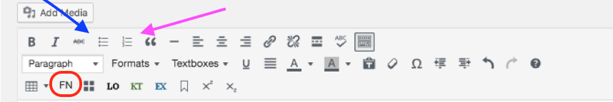
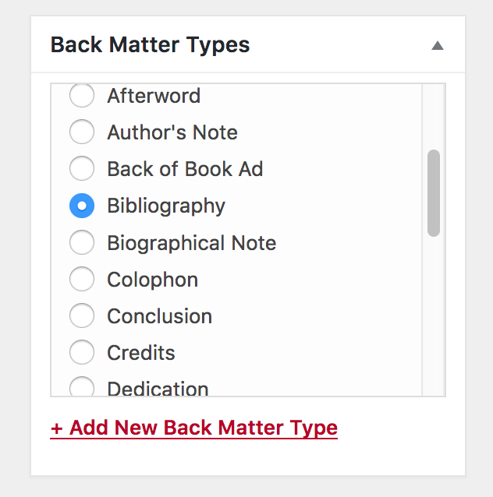
Pressbooks
Notes:
When you’re ready to add an in-text citation and reference list to your book in Pressbooks, here are some tools that can help.
From the Toolbar, you can use
Bulleted list
Numbered list
Footnote (e.g., for in-text citation if using Chicago citation style)
When adding the reference list to the back matter of your book, there is an option in Pressbooks to select Bibliography.
For most citation styles, a reference list is different than a bibliography. A bibliography refers to a list of both the works cited in an author’s writings (like a reference list) AND texts consulted by the author, but not cited. The exception to this usage is with the Chicago citation style which refers to its reference list as a bibliography.

Slide 10
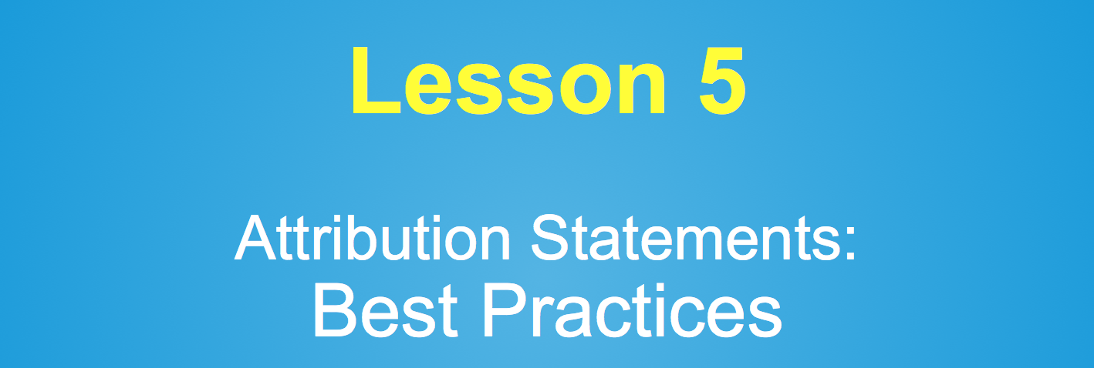
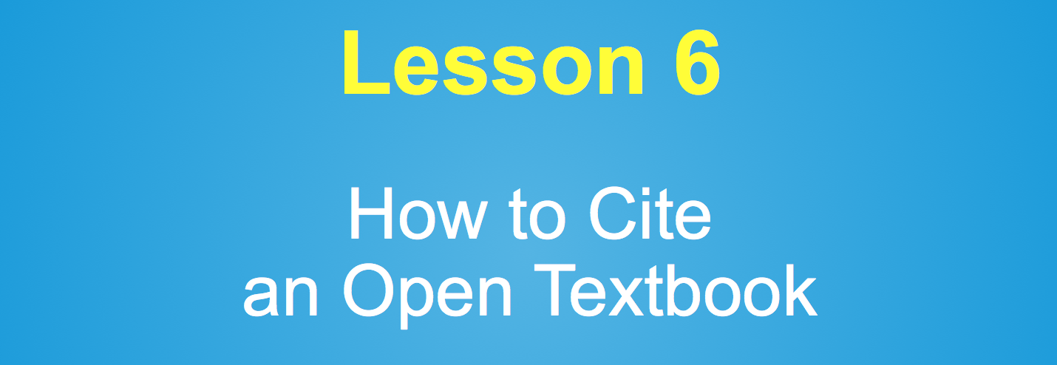
Notes:
We will cover the details of how to attribute an openly licensed work later in Lesson 5: Attribution Statements – Best Practices.
Lesson 6: How to Cite an Open Textbook, will be covered at the end of this presentation.

Slide 11
Lesson 2
The importance of using
Openly Licensed Resources,
Public Domain Resources,
Original Creations

Slide 12
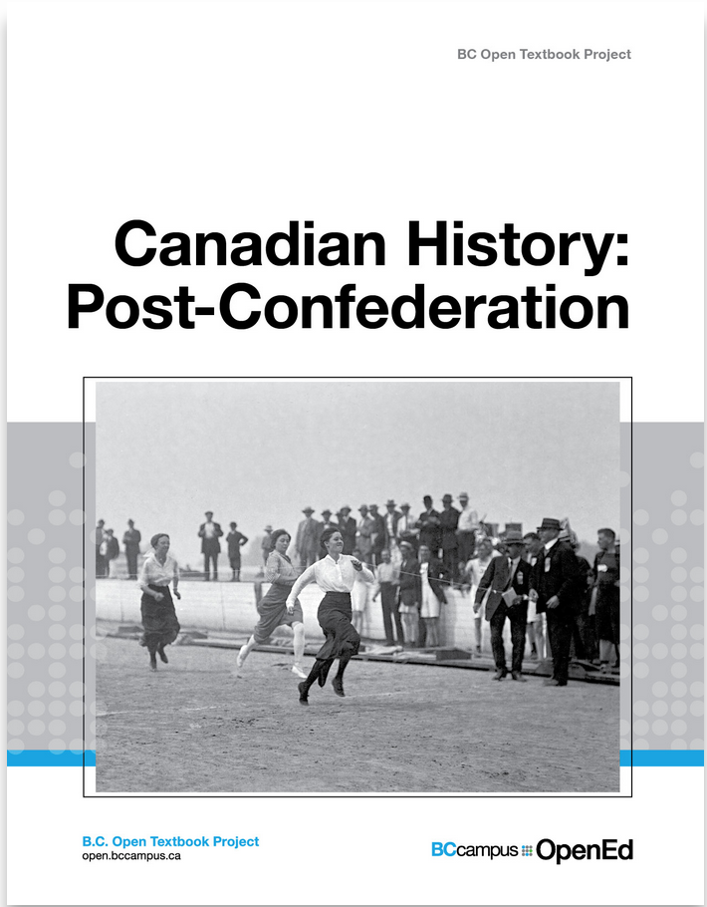
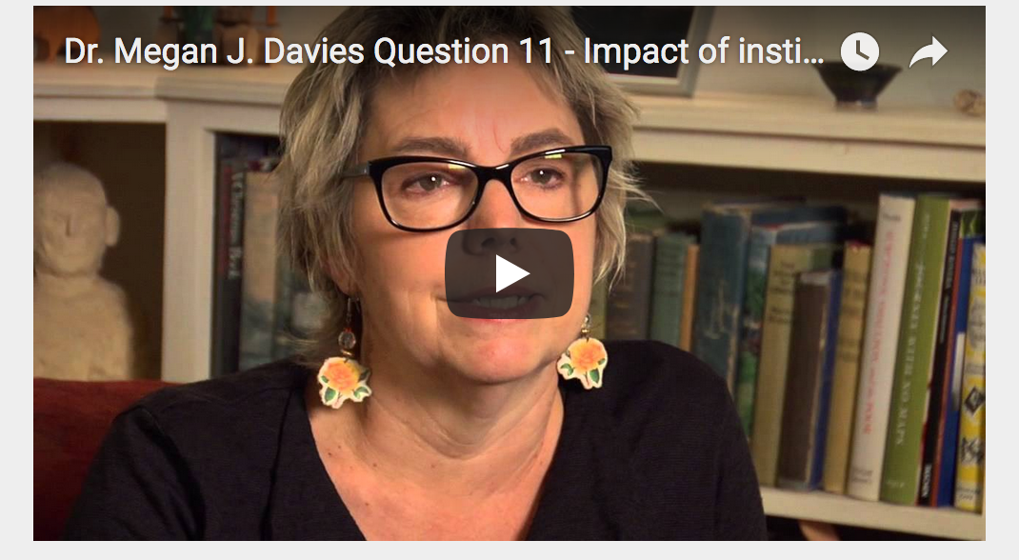
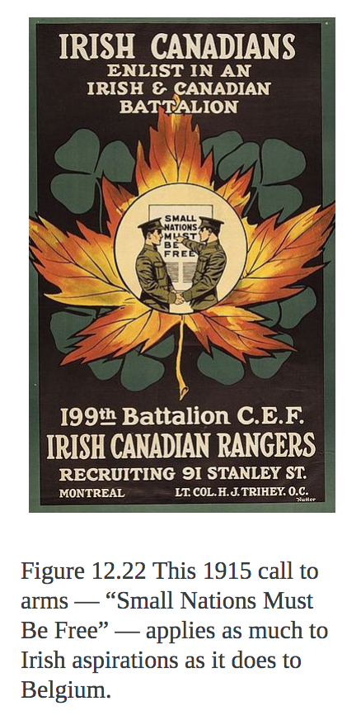
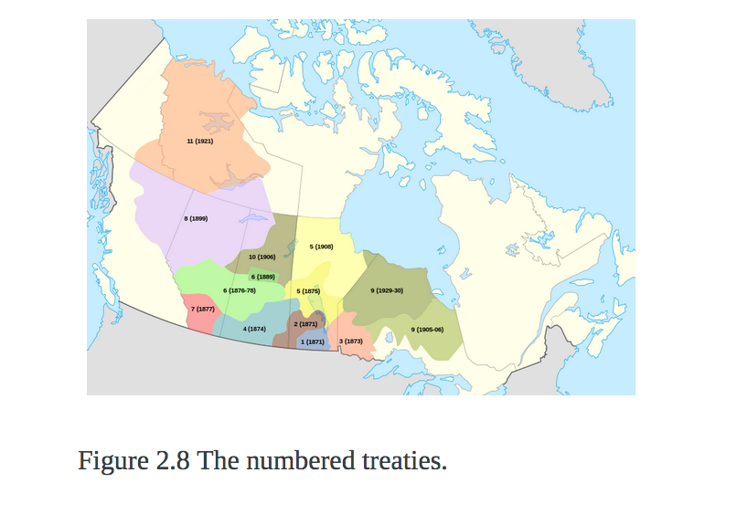
More than the written word
Notes:
Writing a textbook is or should be more than the written word. You’ll likely want to include images, maps, charts, graphics and tables; videos and other multimedia to enhance the book. However, it’s unrealistic – whether writing an open textbook or one that is not openly licensed – to assume that all these resources will be original creations.

Slide 13
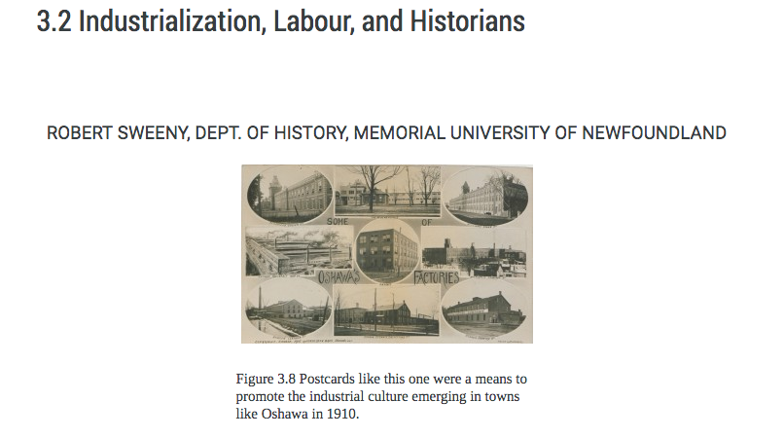
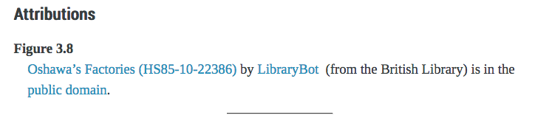
Why is this important?
Notes:
When creating or adapting an open textbook, you’ll want to find resources that have no copyright restrictions, whether through an open copyright licence or is in the public domain.

Slide 14
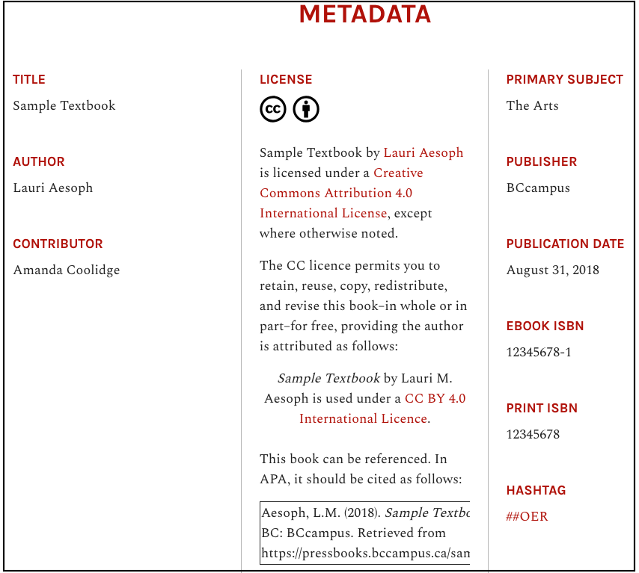
Licence and other information
Notes:
This is important because the CC licence with which an open textbook is released is intended to cover everything in the book including the text, photos, illustrations and other images, graphs, tables, charts, embedded videos, and anything else added to the book.
When you go to the Home page of the web version of a textbook created in Pressbooks, this is how it lays out the copyright and licensing information, and other info that has been added to fields on the Book Info page…
NEXT SLIDE

Slide 15
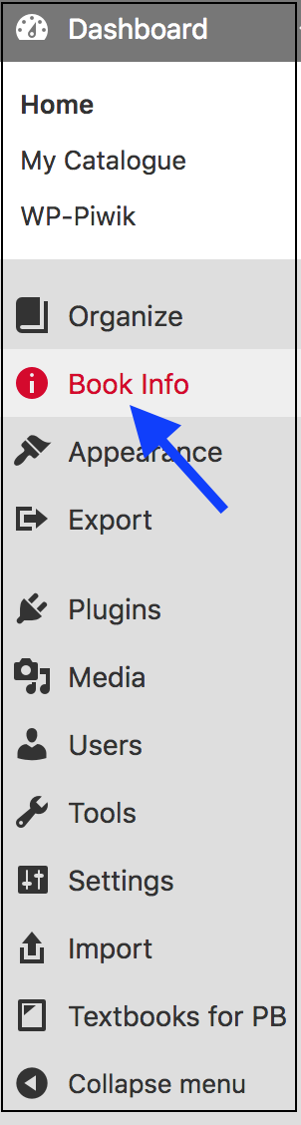
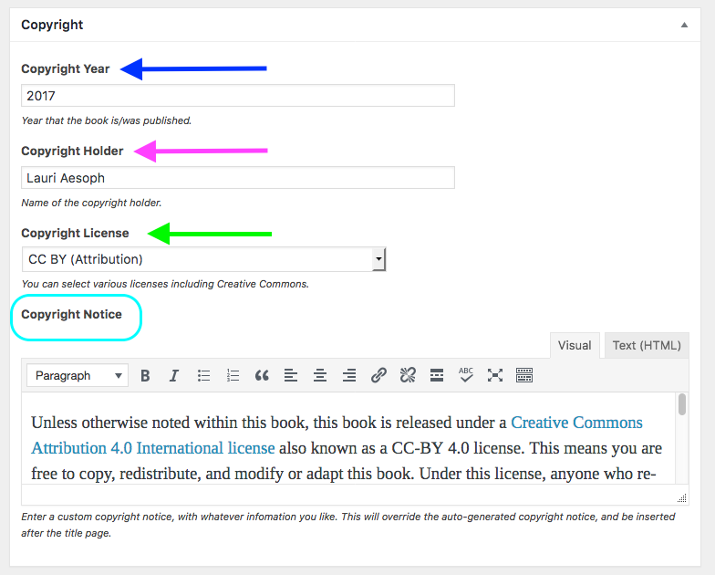
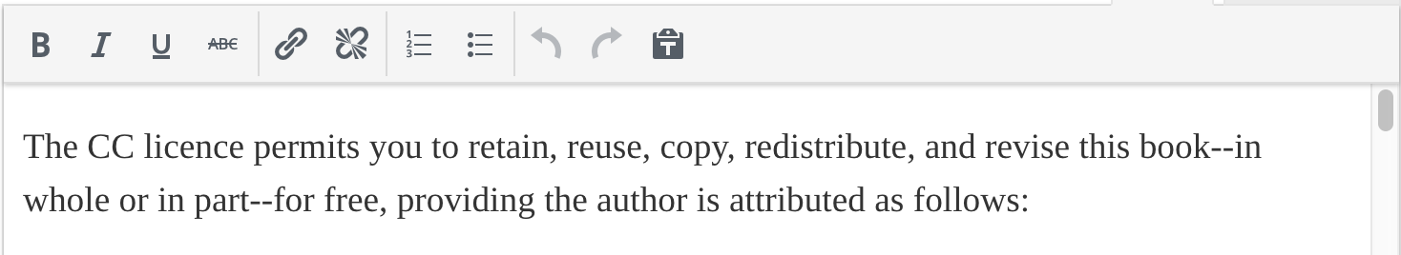
Book Info page: copyright and licence info
Notes:
Here is how the Book Info page is accessed for a book through the Dashboard.
In the screenshot on the right, is where copyright information and copyright licence info are added:
Copyright Year
Copyright Holder or who owns the copyright for the textbook
Copyright License is where the type of Creative Commons open-copyright licence is selected from a drop-down list. Public domain and All rights reserved are also options.
Copyright Notice field is where details about copyright and the licensing of a textbook are added.

Slide 16
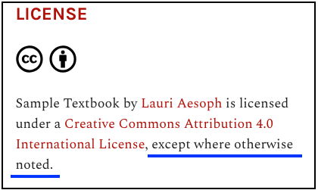
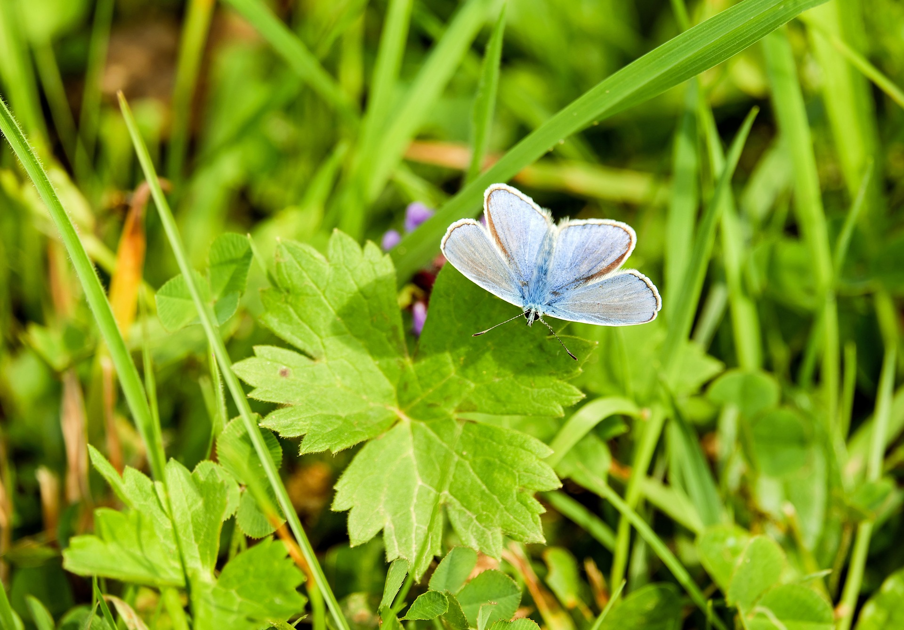
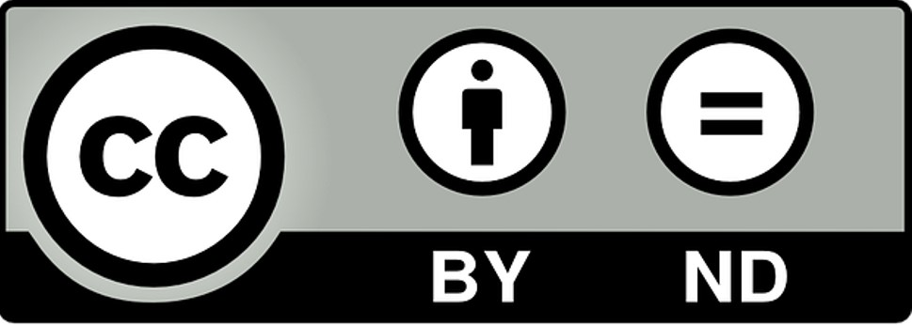
Exceptions
Not accepted by B.C. Open Textbook Collection.
This photo is copyrighted by Lauri Aesoph. Used with permission.
Notes:
Textbooks created with BCcampus funding are typically released using the most open copyright licence: CC BY (Creative Commons Attribution). We encourage the authors we work with to select borrowed elements (photos, illustrations, etc.) also covered by a CC BY licence or in the public domain. However, when that isn’t possible, items released with slightly more restrictive licences such as CC BY-NC (NonCommercial) or CC BY-SA SshareAlike) are acceptable. Notice the language added to the Copyright Notice field that appears on the book’s Home page: “except where otherwise noted.”
Not accepted for the textbooks created by our project are:
Creative Commons licences that include the ND (NoDerivatives) condition because this restricts users from making changes to the material. The ability to revise and remix part or all of an openly licensed textbook are key.
Using items for which the author has secured one-time permission to use in the textbook. Unless the permission includes releasing the item to the open textbook author with a CC licence, this arrangement is undesirable because it does not permit other users to practice all of the rights assigned to the rest of the book: to reuse, retain, redistribute, revise, and remix.

Slide 17
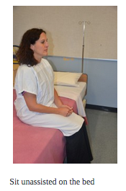
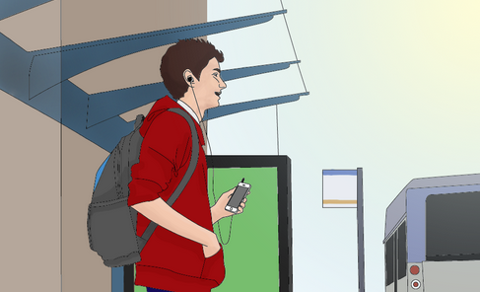
Original creations
2. Original illustration from the
B.C. Open Textbook Accessibility Toolkit – 2nd edition
1. Original photo from
Clinical Procedures for Safer Patient Care
Notes:
You can also choose to create or hire someone else to create original resources, as long as the creator understands that the item will be released under an open copyright (Creative Commons) licence. These might be photos, illustrations, or other images or objects. Here are a couple of examples:
All photos used in the Clinical Procedures for Safer Patient Care textbook were taken by the authors.
Many of the illustrations in the B.C. Open Textbook Accessibility Toolkit- 2nd edition were original drawings created by a BCcampus employee and a contracted illustrator.

Slide 18
Lesson 3
Where to find
Openly Licensed Resources
Public Domain Resources
Notes:
Next, we’re going to look at where you can find resources or media either released with an open-copyright licence (such as Creative Commons) or copyright free (in the public domain).

Slide 19
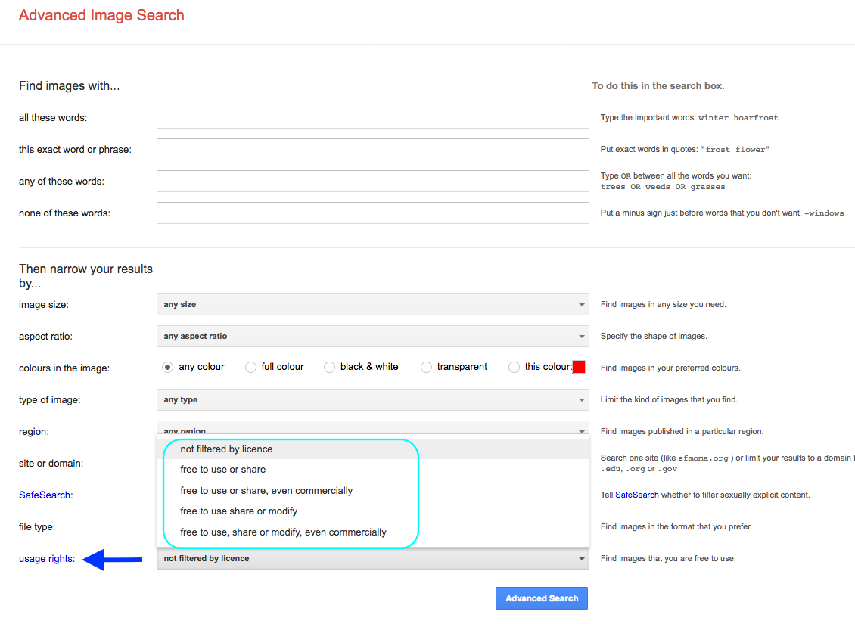
Search engine
google.com/advanced_image_search
Notes:
In the Advanced Image Search view of Search engine, Google, you can use the “usage rights” dropdown menu to select what permissions you want for the items you are looking for.

Slide 20
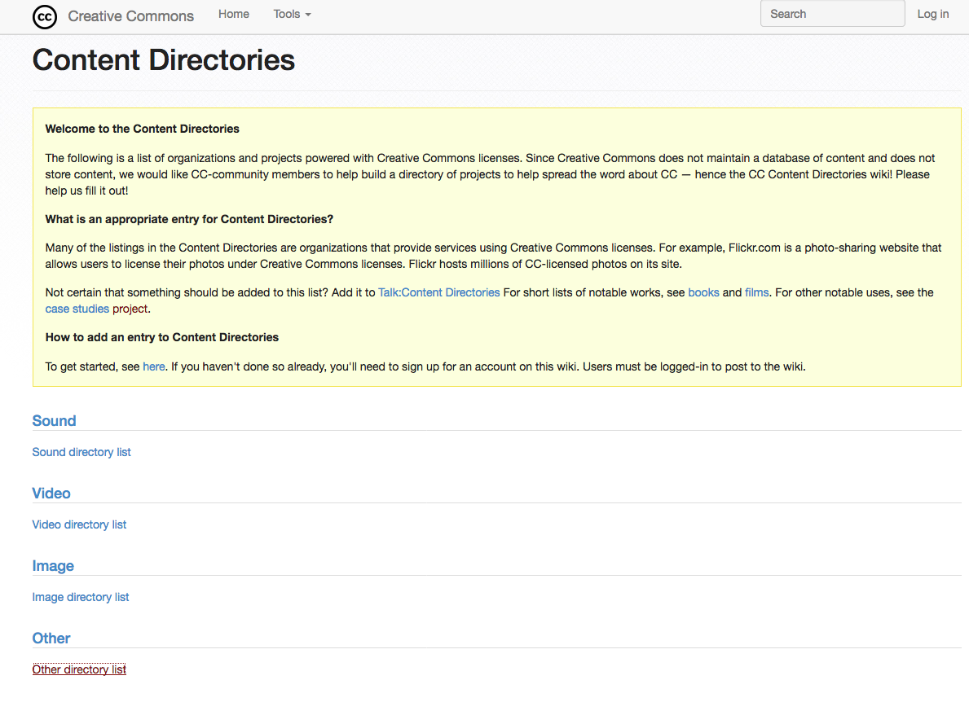
Directory
wiki.creativecommons.org/wiki/Content_Directories
Notes:
Directories, such as the Content Directory run by Creative Commons, contain links to repositories that house openly licensed or copyright-free media. You can see here, that the Creative Commons directory separates media by type: sound, videos, images, and other.

Slide 21
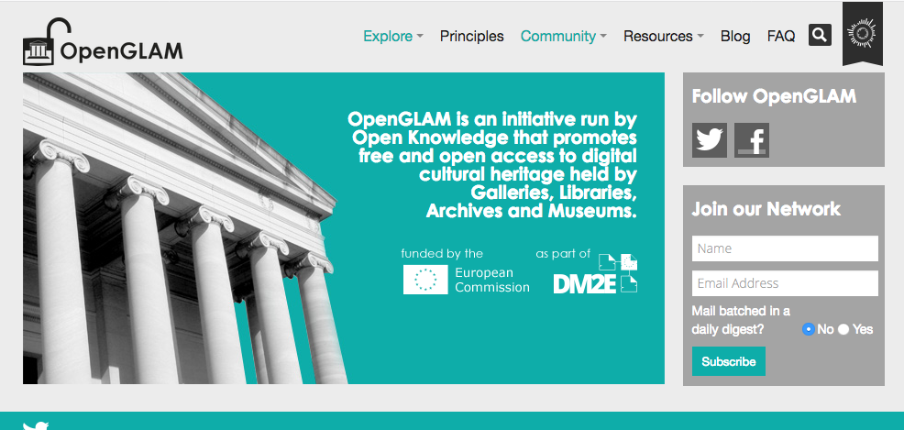
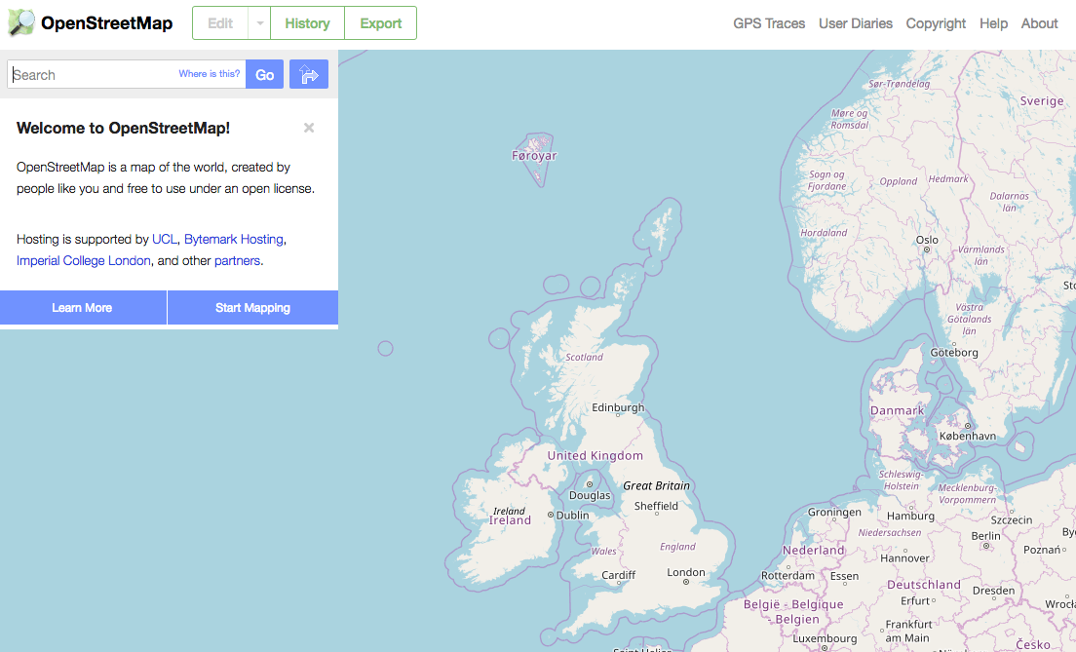
Special collections
openglam.org
openstreetmap.org
Notes:
Specialized collections are forming that allow authors to more easily focus searches for their subject areas. Here are a couple of examples:
OpenGLAM. GLAM stands for “Galleries, Libraries, Archives, and Museums” and contains media and resources made openly available by those institutions.
Open Street Map contains maps of the world that are openly licensed.

Slide 22
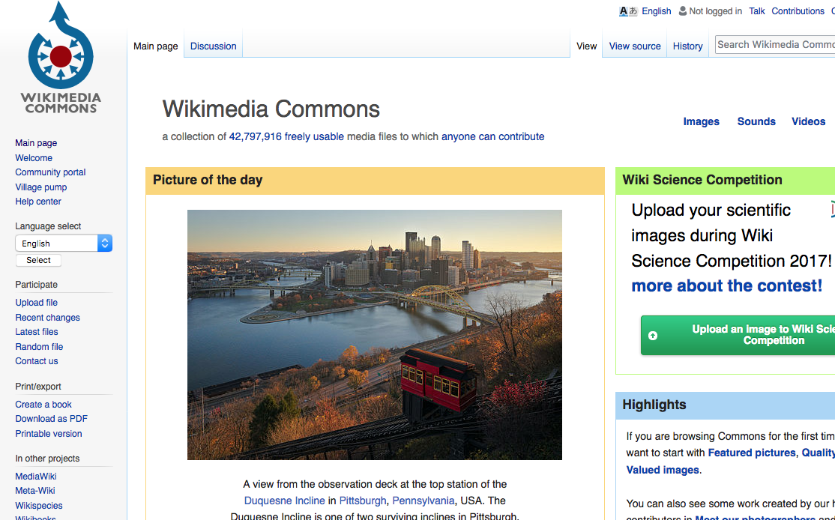
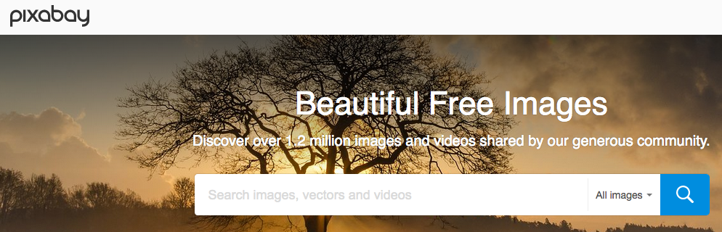
General collections
commons.wikimedia.org
pixabay.com
Notes:
You can look at large general collections like Wikimedia Commons and Pixabay.
Wikimedia contains media available in the public domain and are under a variety of open-copyright licences.
Pixabay contains copyright-free images and videos. All content is released under Creative Commons CC0.

Slide 23
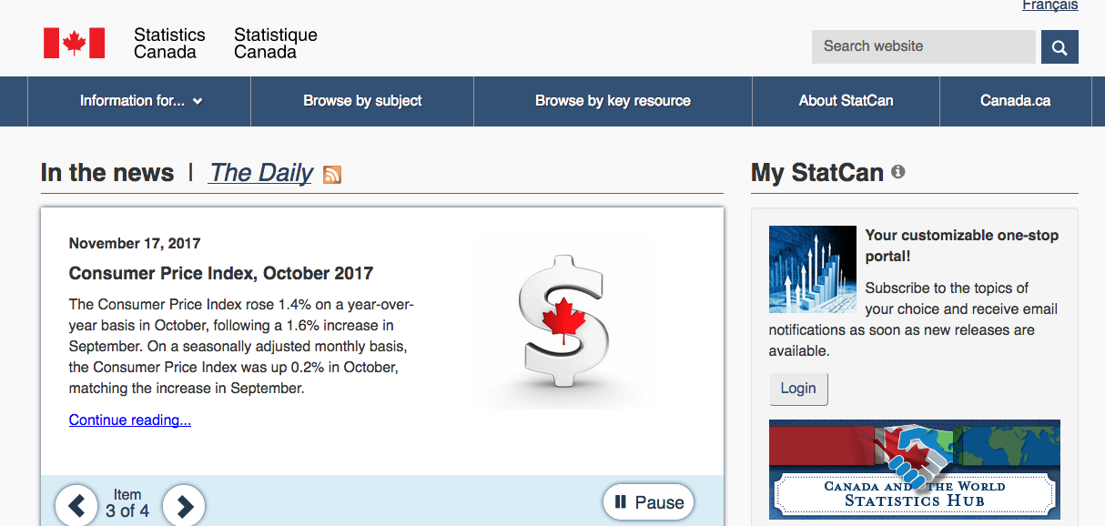
Government resources: Canada
statcan.gc.ca
Notes:
Most government of Canada websites and publications are covered by the open government licence. However, when using a resource from a Canadian government website or publication, always check the Terms of Use, Copyright, or similar page for details. One example are the resources on the Statistics Canada website.
Often, images and other resources from a Canadian government website stipulates that the reused image or resource not be used for commercial purposes. If this is the case, then add this line to your attribution statement: “This image cannot be used for commercial purposes.”

Slide 24
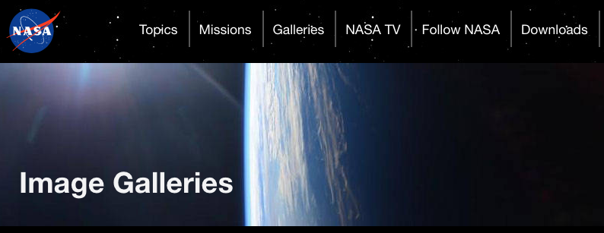
Government resources: U.S.
nasa.gov
Notes:
Generally the information and images found on U.S. government websites are in the public domain. One example is NASA. However, when using a resource from a U.S. government website, always check the Terms of Use, Copyright, or similar page for details.

Slide 25
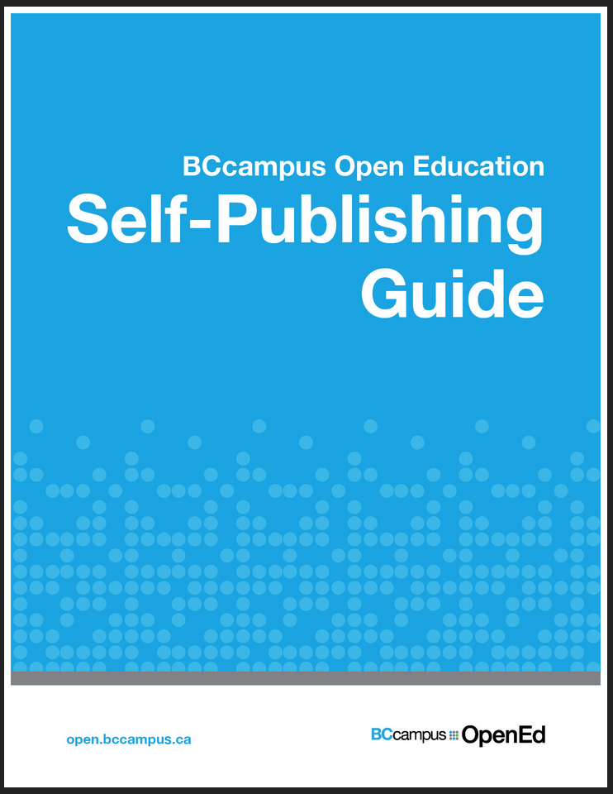
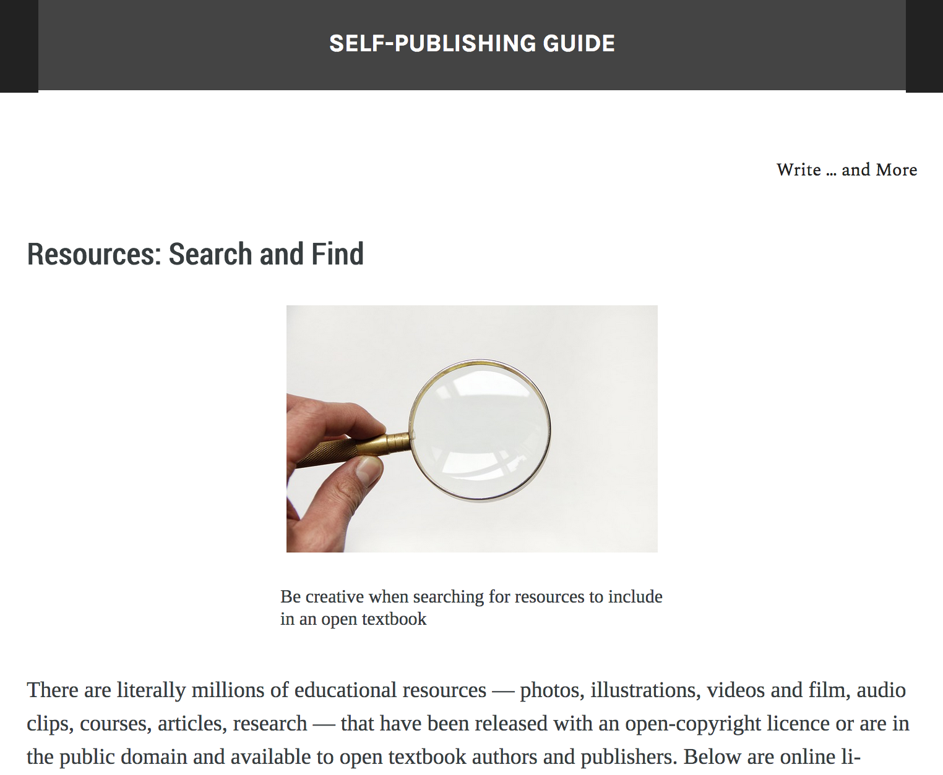
And more…
opentextbc.ca/selfpublishguide
Notes:
You will find links to more resources in the “Resources: Search and Find” chapter of the BCcampus Open Education Self-Publishing Guide.

Slide 26
Lesson 4
Tables:
A Special Case

Slide 27
Where are all the openly licensed tables?
DESSERTS | Ice Cream | Cake | Toppings
Combo 1 | chocolate | marble | whipped cream
Combo 2 | strawberry | pound | nuts
Combo 3 | vanilla | lemon | cherries
Combo 4 | licorice | chocolate | gummy bears
Combo 5 | salted caramel | Angel food | mixed berries
Combo 6 | butterscotch | Devil’s food | white chocolate
Combo 7 | Rocky Road | yellow | butterscotch
Combo 8 | orange | vanilla | sprinkles
Table 4.2 Dessert options. (Copyright 2017. All rights reserved.)
Notes:
When we were publishing open textbooks, we found that there were very few openly licensed tables that were useful to the authors we were working with. That’s not to say that our authors couldn’t find tables they could use. Only that the ones they did find were typically restricted.
So, with the help of our copy editors, we developed a way to present information in table format without infringing on copyright.

Slide 28
There are two parts to a table
1. Style
MAIN LABEL | Column One | Column Two | Column Three
ROW #1
ROW #2
ROW #3
2. Data
MAIN LABEL | Column One | Column Two | Column Three
ROW #1 | Information 1 | Information 2 | Information 3
ROW #2 | Information 4 | Information 5 | Information 6
ROW #3 | Information 7 | Information 8 | Information 9
Notes:
We learned during our research that a table is comprised of two parts:
The style or layout of the table which acts as the container for information
These elements can include the size, placement, colour of the cells; the style and placement of fonts; the wording and placement of column and row labels.
The data or information contained within the table

Slide 29
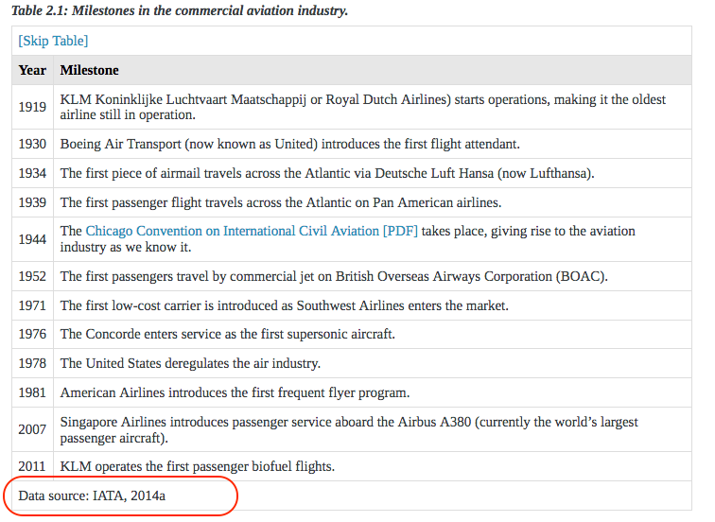
New table with cited data
Notes:
Our solution was to instruct authors to create an original table, and then cite the data added to that table. As you can see in this example from Introduction to Tourism and Hospitality in BC, we used the last row in the table to hold the in-text citation which was then provided in full in the book’s referencelList. For clarity, we labelled the in-text citation as “Data source.”
The original table, created by the author or a designer working with the author, is an original creation. Because of this, no attribution statement is required. The table design is copyrighted by the author (or designer); this copyright information is noted in the Copyright Notice field on the Book Info page of Pressbooks.
This same process can be applied to charts and graphs.

Slide 30
Lesson 5
Attribution Statements:
Best Practices

Slide 31
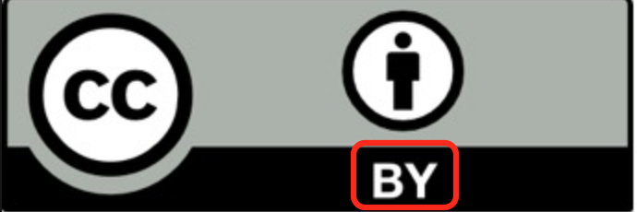
BY = attribution
Creative Commons Attribution
4.0 International Licence
CC BY 4.0
Notes:
In the world of open-copyright licences, it’s important to understand the most basic legal requirement to use these licences: attribution.
For CC or Creative Commons licences the word “attribution” is spelled out in the full label. In the commonly used CC BY abbreviation, “BY” refers to attribution (giving credit to the creator), in other words, who the work is “by.”

Slide 32
Best practice: open-copyright licence (CC)
Element | Example
Title of work | Horse https://flic.kr/p/47g8Ke
Author or creator | Cindy Funk https://www.flickr.com/photos/cindyfunk/
Licence | CC BY 2.0 https://creativecommons.org/licenses/by/2.0/
Notes:
There are a variety of situations where attribution can be applied. We most commonly talk about attributing media or resources that are copyrighted but released with an open-copyright licence such as a Creative Commons licence, open government licences, or other open-copyright licences.
In this situation, the ideal attribution statement is comprised of three elements:
Title of the work, and a link to the media’s original web page. In this case, the photo was found on flickr and is called “Horse.”
Author or creator of the work, and a link to their home web page. In this case, the photographer, Cindy Funk, has a page on flickr.
Licence type and a link to a description of this licence.

Slide 33
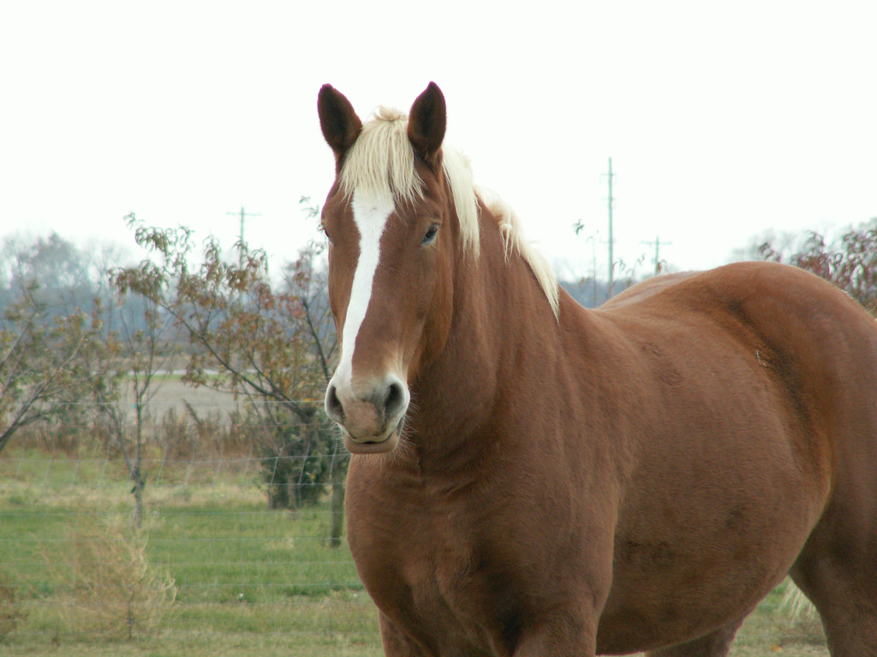
Horse by Cindy Funk is used under a CC BY 2.0 Licence.
Notes:
Here is the photo and this is what the attribution statement looks like. “Horse”, “Cindy Funk”, and “CC BY 2.0” are each hyperlinked to their respective web pages.
An attribution statement, like this, is often part of an “Attributions” list at the bottom of the printed or web page.

Slide 34
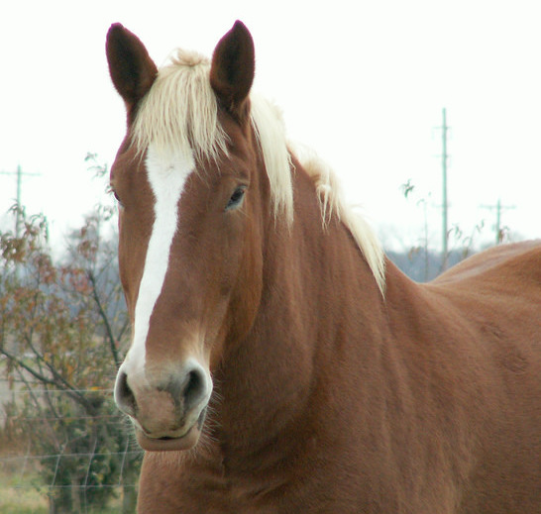
Horse by Cindy Funk has been modified (cropped)
and is used under a CC BY 2.0 Licence.
Notes:
If you have modified the image in some way, you must indicate this in your attribution statement. For example, if the Horse photo has been cropped, that must be noted in the attribution statement. In this case the attribution now says: “Horse by Cindy Funk has been modified (cropped) and is used under a CC BY 2.0 Licence.” The phrase “has been modified (cropped) and…” has been added.
Note that if an image includes “ND” (NoDerivatives) as part of the CC licence, the image cannot be changed. This includes cropping.

Slide 35
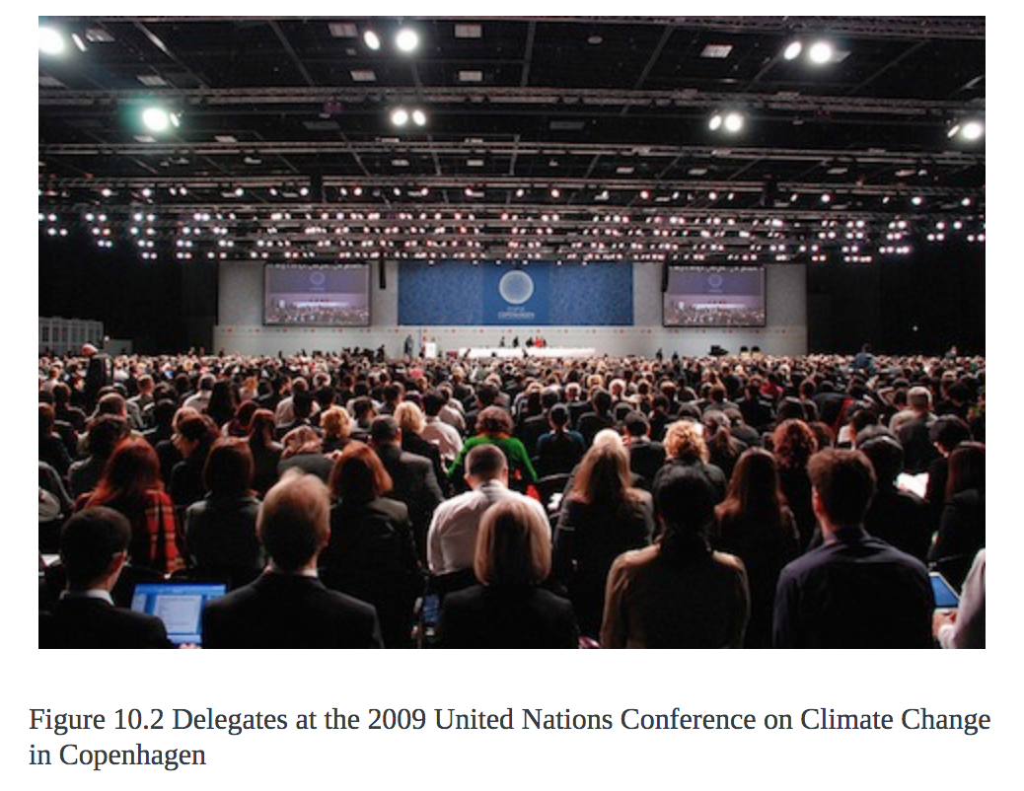
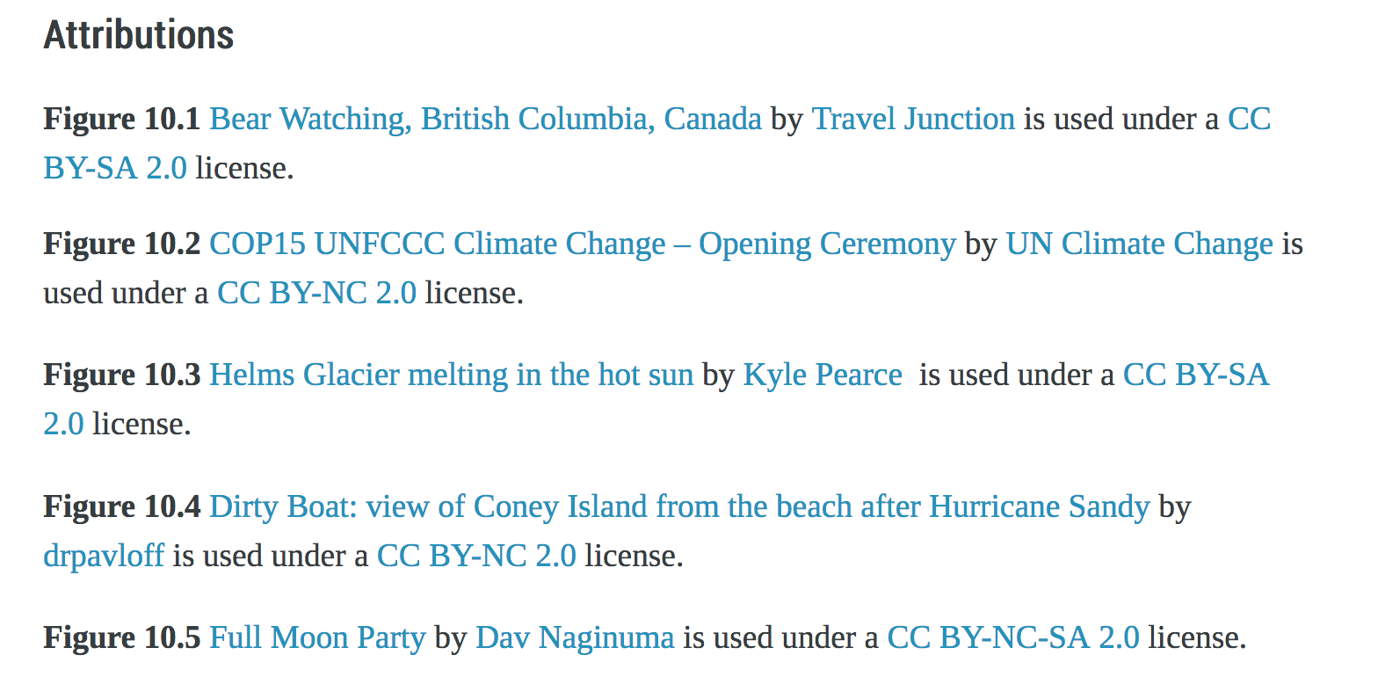
#1
#2
Notes:
Here is an example of an Attributions list from the open textbook, Introduction to Tourism and Hospitality in BC.
Number 1 is the openly licensed photo taken by someone other than the author and added to this book. Notice that a caption is used and the photo is designated as “Figure 10.2.” This means that this photo appears in chapter 10, and is the second figure. We found it useful to label each resource in this way so it could be easily identified in the Attributions list.
Number 2 shows the Attributions list with attribution statements for all photos and other media that appear on this web page of the book. This list is placed at the bottom of the page and is done for each web page of the book in Pressbooks.

Slide 36
What about text?
This paragraph is the one I borrowed from another open textbook
author. I want to make sure that I show in my attribution statement at the
bottom of this page where this borrowed paragraph came from.
Here’s the paragraph that I wrote. I don’t need to give credit to anyone
else for this paragraph because I wrote it all by myself. And I think it is
rather well written. Don’t you?
Attributions
First paragraph: Sample Textbook by Someone Else is used under a
CC BY 4.0 Licence.
Notes:
It’s not just openly licensed media that should be clearly identified and attributed when writing or revising an open textbook; text should be too. Text can be harder to attribute particularly when the “borrowed” text is inserted or blended into your own work.
Like photos, illustrations, and other media, an attribution statement for the text should be provided on the page for which the borrowed open text is used. It can be listed with other attribution statements at the bottom of the paper or web page. If borrowed text is blended into the page’s other text, you should identify placement in the attribution statement. This slide shows an example.

Slide 37
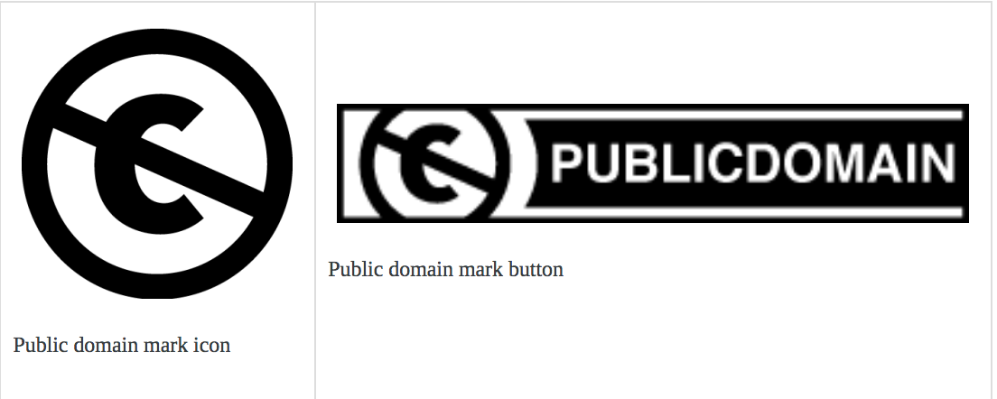
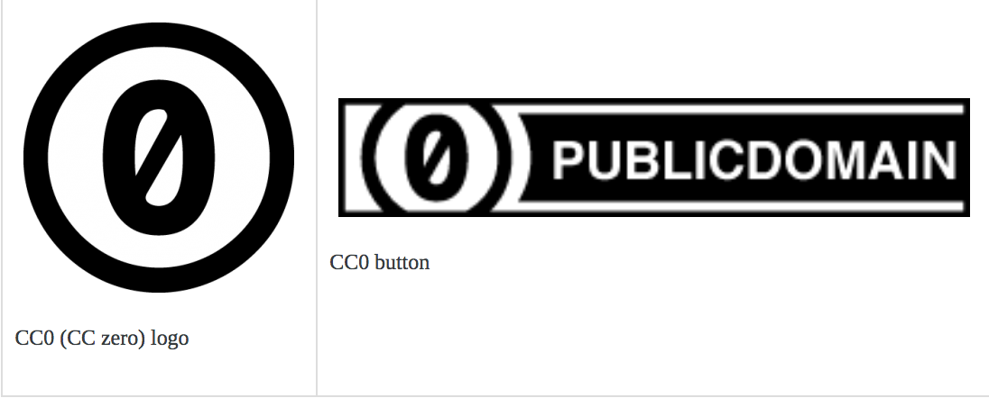
Best practice: no copyright
Attribution can/should also apply to resources:
In the public domain
(copyright expired)
Dedicated to the public
domain by the copyright
holder
Notes:
It has been the practice of BCcampus to provide attribution for works that reside in the public domain, in other words, have no copyright. Legally this is not required. However, we do this as a gesture of academic courtesy and integrity.
There are two main ways that a work ends up in the public domain.
When copyright has expired. This varies from country to country, but for Canada the copyright for a work usually expires 50 years after the death of the creator, at the end of the relevant calendar year. A public domain mark might be used to identify these works.
Update, Oct 1, 2018: In the new NAFTA agreement, renamed the U.S.-Mexico-Canada Agreement or USMCA, the copyright term of protection has been increased from 50 years to 70 years. U.S. Congress must vote, likely in 2019, before the USMCA is accepted by the U.S.
If the creator of a work elects to designate their creation to the public domain and not retain copyright, then the CC0 (CC zero) logo can be used identify it.

Slide 38
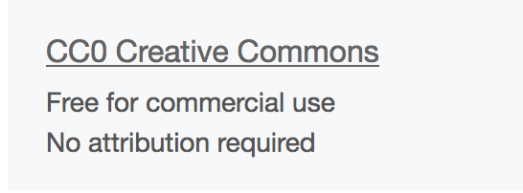
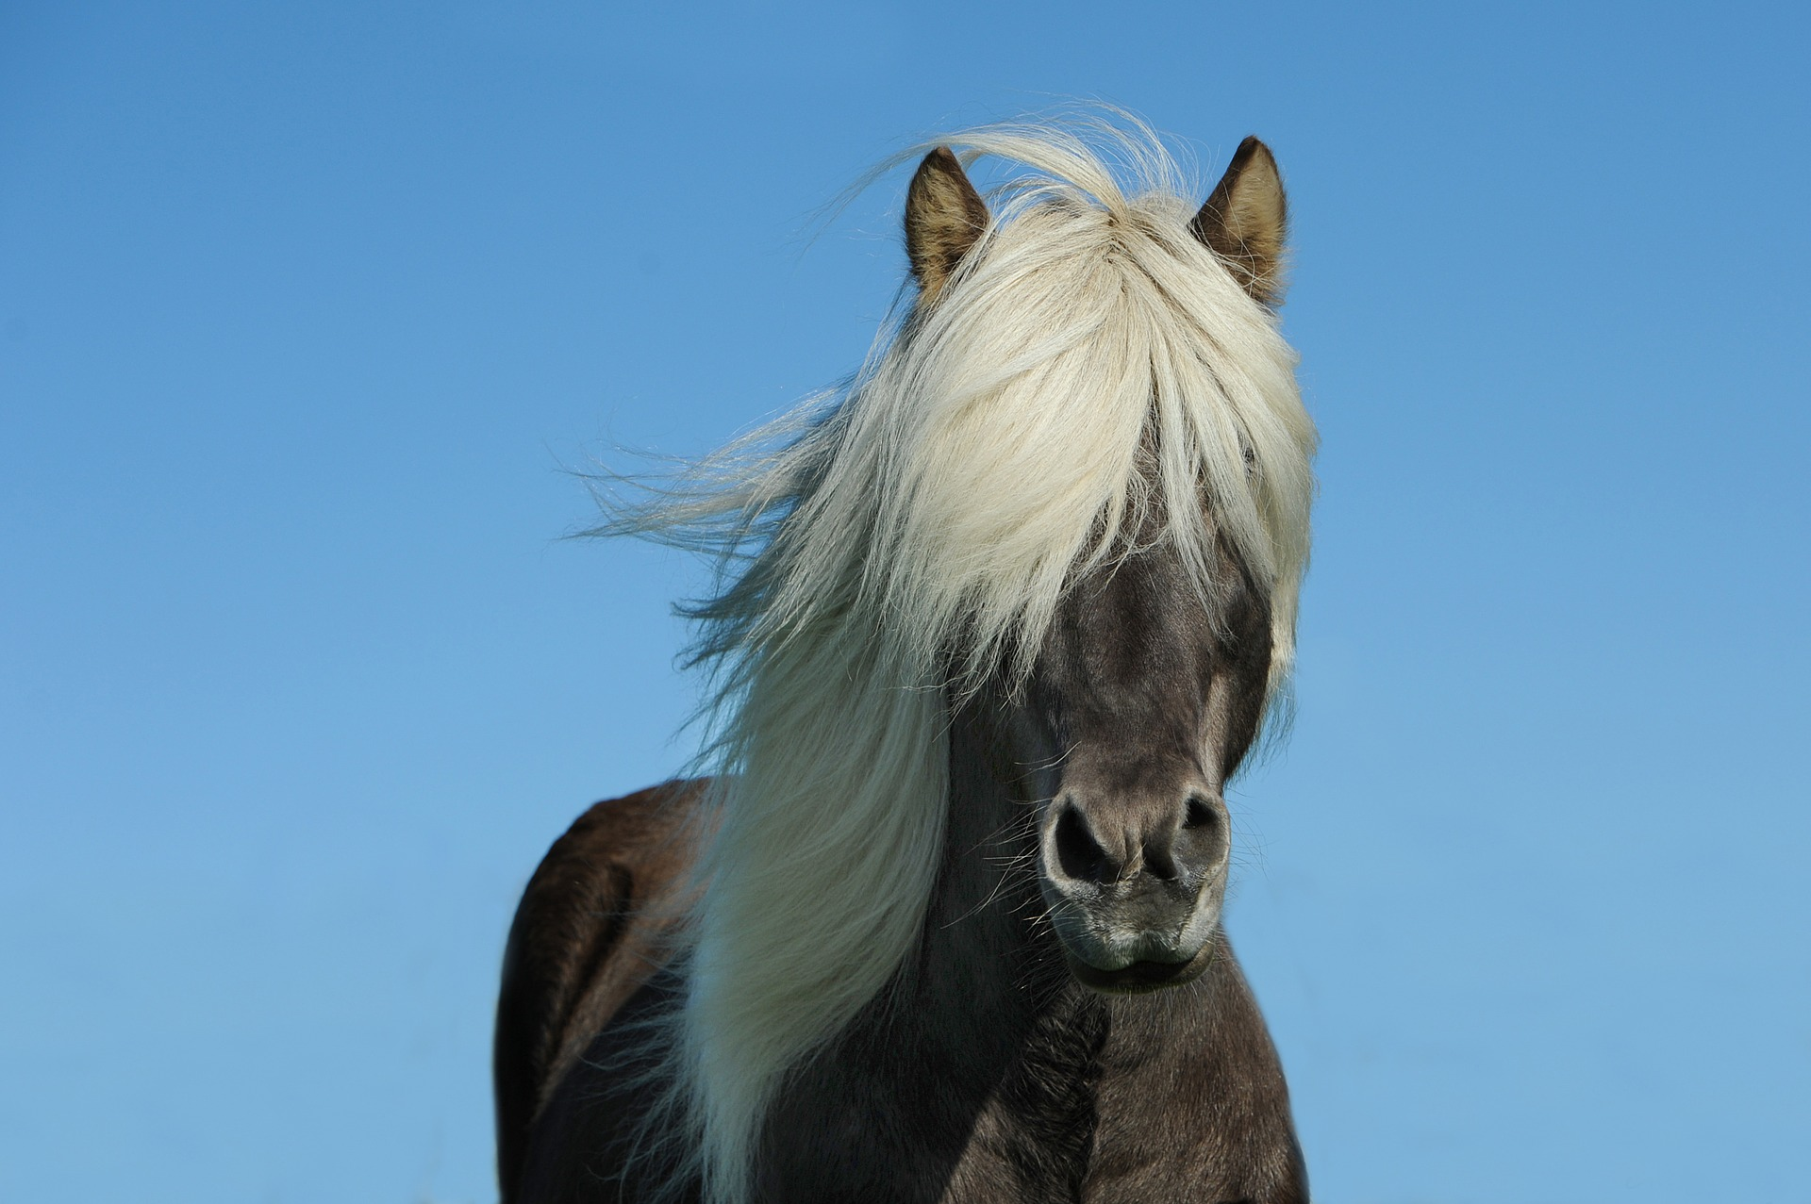
Horse by Blaer is found in the public domain.
Notes:
This photo has been designated to the public domain and is identified with the CC0 (zero) logo in Pixabay. However, if we choose to give the creator credit, it can be done like this: Horse by Blaer is found in the public domain.
“Public domain” in the attribution statement is then linked to a description of public domain.

Slide 39
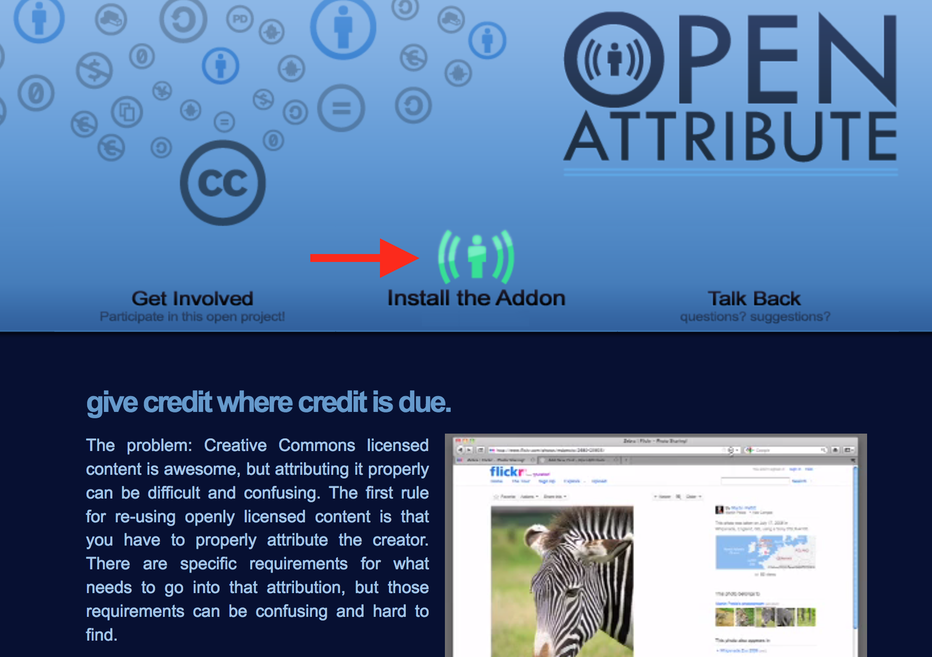

Tool #1: Open Attribute (openattribute.com)
#1
Select browser
#2
Notes:
If you want to use a tool to create an attribution statement, the browser add-on called “Open Attribute” is an option.
Click on “Install the Addon” icon
Select the browser to use
NEXT SLIDE

Slide 40
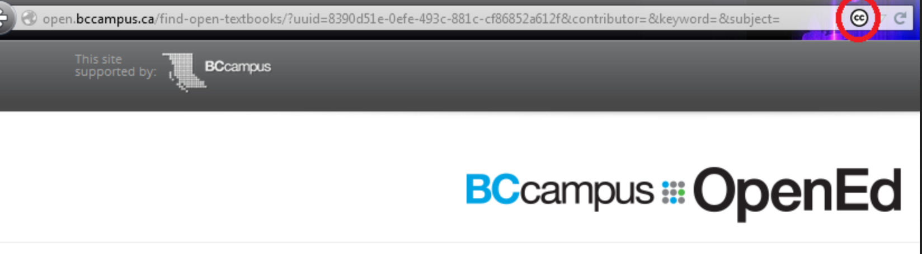
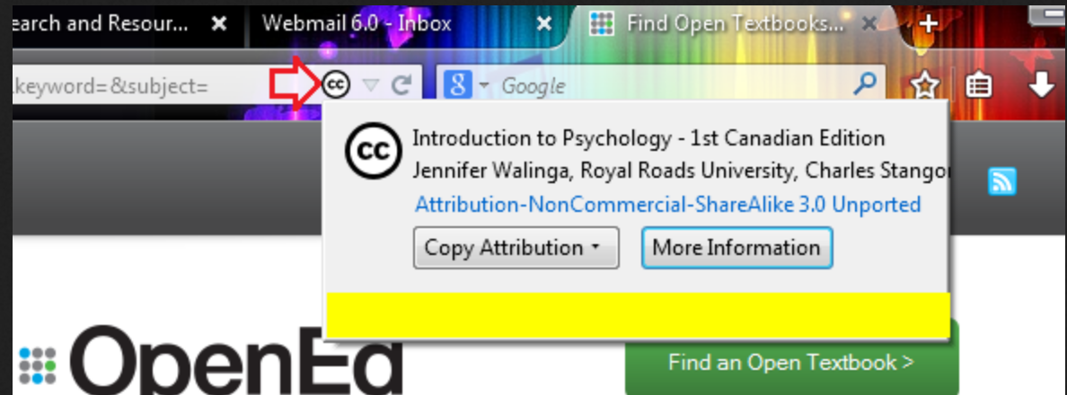
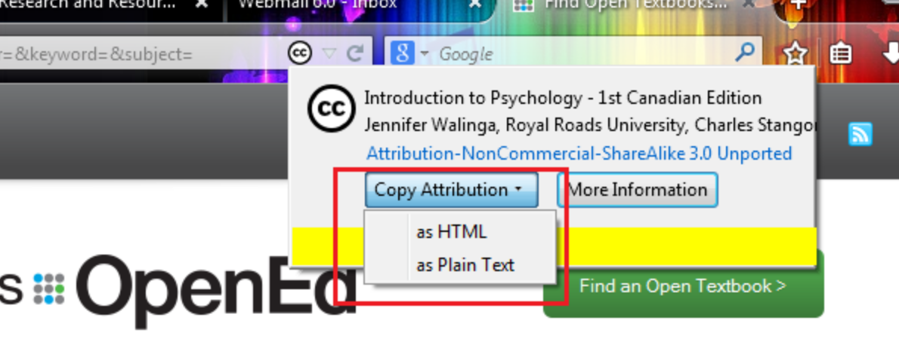
1. CC logo appears
2. Click on logo
3. Select attribution
Notes:
After installing this add-on:
1. A small CC logo will appear in the address bar of the browser when a website that contains CC licensed content is visited.
2. Clicking on the CC logo will reveal a drop-down menu
3. That allows you to select and then copy the attribution for that item in either HTML or plain text
The advantages of this tool are:
There is no need to go to another web page and manually enter data into text fields.
It is quick.
It tracks all of the elements required for a complete attribution.
It responds to the correct metadata connected with CC licensed content.
The disadvantages:
you must install the add-on and
if a website does not use CC metadata, this add-on will not work.

Slide 41
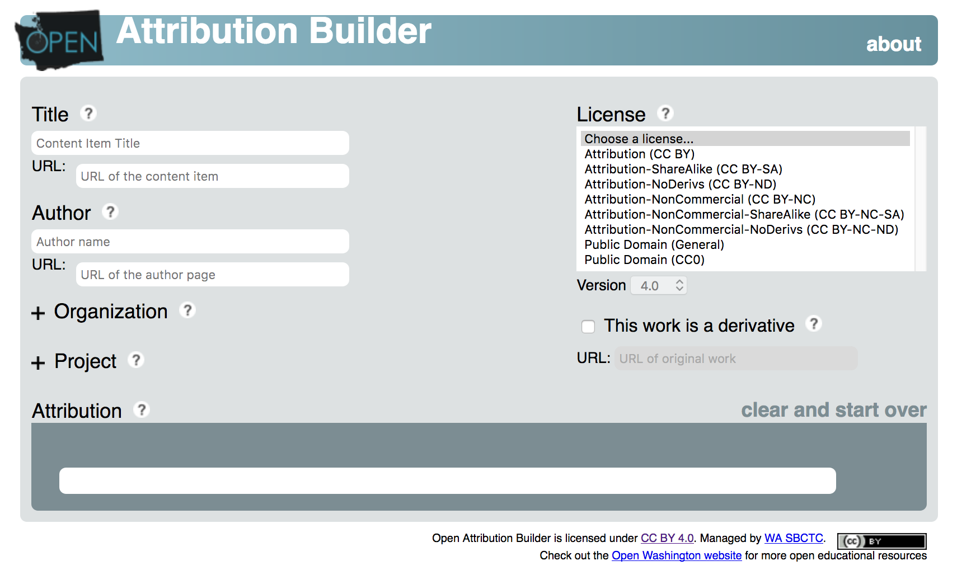
Tool #2: Open Attribution Builder
openwa.org/attrib-builder/
Notes:
The Open Attribution Builder from Open Washington and the Washington State Board for Community and Technical Colleges can also be used to create attribution statements. It is simple to use and provides descriptions for each field through the “?” icon.
The advantages are:
No installation is required.
Licences and versions can be chosen with drop-down menus.
It includes the option to attribute work that is a derivative (adaptation).
It provides an attribution statement as plaieithern text or HTML.
If a CC resource is found that doesn’t have the correct metadata, it creates a well structured HTML attribution.
The disadvantages are:
You must go to a separate website to use.
It doesn’t include CC metadata.

Slide 42
Lesson 6
How to Cite
an Open Textbook
Notes:
At BCcampus, we are often asked “How to cite an open textbook?”.

Slide 43
Why cite an open textbook?
There is no legal requirement to cite an open textbook if it has been released with an open copyright licence.
Other reasons to cite:
Academic integrity
Recognize efforts and expertise of a colleague
Provide primary evidence to support text
Notes:
As mentioned earlier, the open-copyright licence applied to an open textbook or its designation to the public domain legally precludes the need to cite it in a scholarly work or homework assignment. Instead, attribution statements are created to indicate that material from an openly licensed book was used and, therefore, fulfills the legal requirement of the textbook's licence.
However, scholars and students may want to cite your work as a way to recognize your efforts and expertise, and to adhere to the standard practice of academic integrity.

Slide 44
Citation examples
APA: Doyle, G. R., & McCutcheon, J. A. (2015). Clinical Procedures for Safer Patient Care.
Victoria. BC: BCcampus. Retrieved from
https://opentextbc.ca/introductiontosociology2ndedition/.
Chicago: Doyle, Glynda and Jodie McCutcheon. Clinical Procedures for Safer Patient Care.
Victoria. BC: BCcampus, 2015. https://opentextbc.ca/introductiontosociology2ndedition/.
MLA: Doyle, Glynda Rees and Jodie Anita McCutcheon. Clinical Procedures for Safer Patient
Care. BCcampus, 2015, https://opentextbc.ca/clinicalskills/. Accessed 27 Oct. 2017.
Notes:
Citing an open textbook is not unlike citing any textbook. Therefore, as the author of an open textbook, it is your job to provide the elements required for a complete reference, regardless of citation style. Most university and college libraries provide citation guidelines on their websites.
Make sure the following are listed in your completed textbook: textbook title, author(s) or editor(s), copyright year, and publisher name and place. It is also helpful to provide, as part of your textbook, an example or two, that shows how to cite your work.
This slides shows some examples.

Slide 45
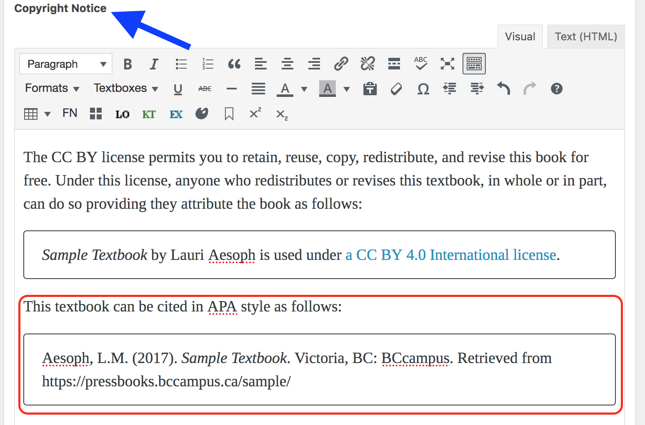
Where to put a citation example?
Notes:
In Pressbooks, authors often provide a citation example in the Copyright Notice field on the Book Info page. The reader will see this information…
NEXT SLIDE

Slide 46
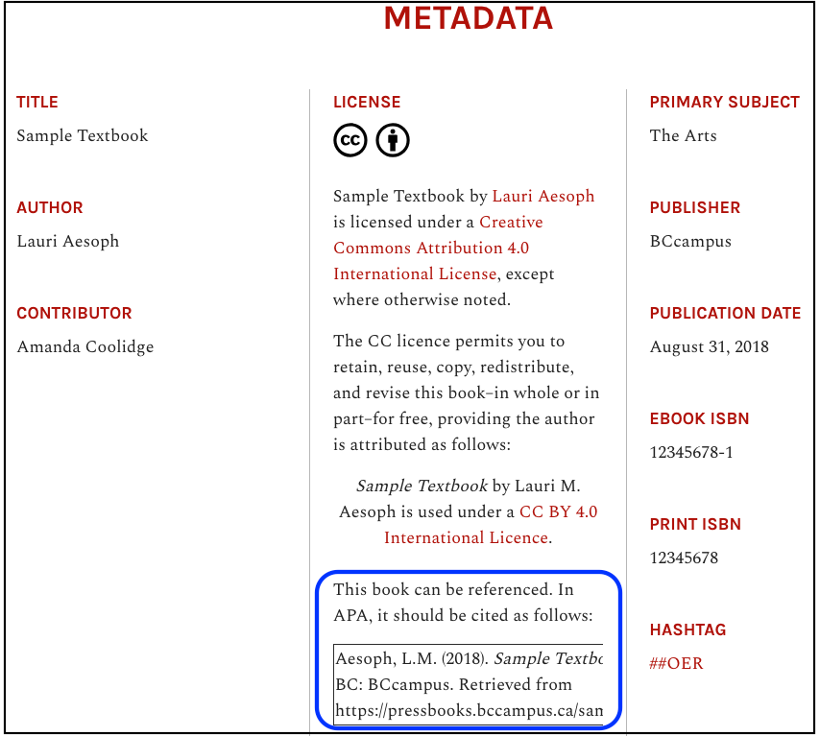
Notes:
…posted at the bottom of the Home page of the web version under the “Metadata” heading.

Slide 47
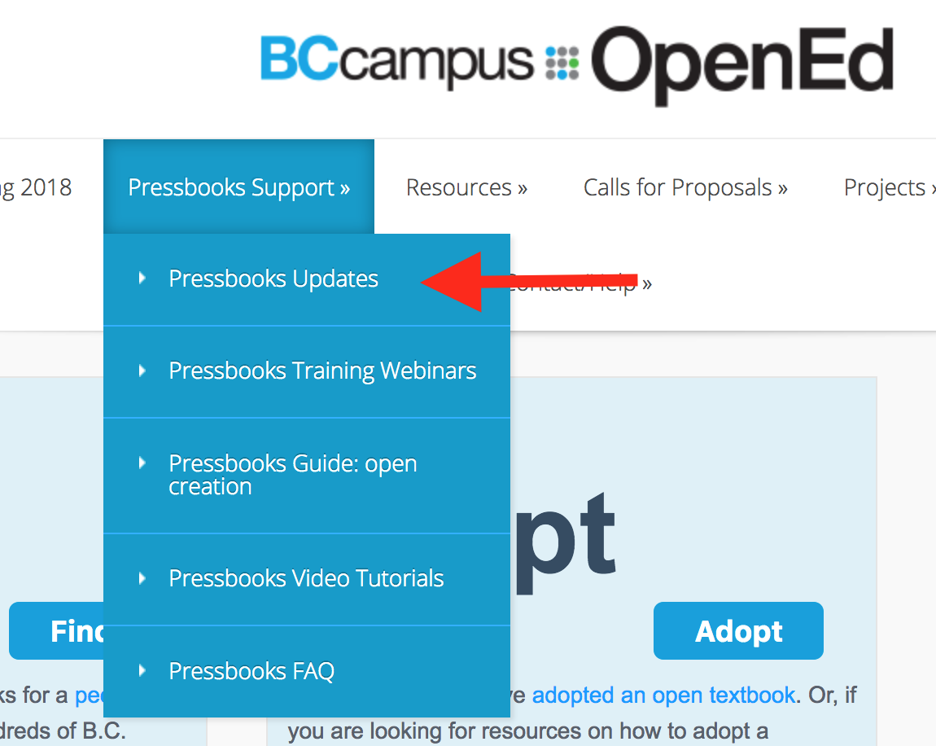
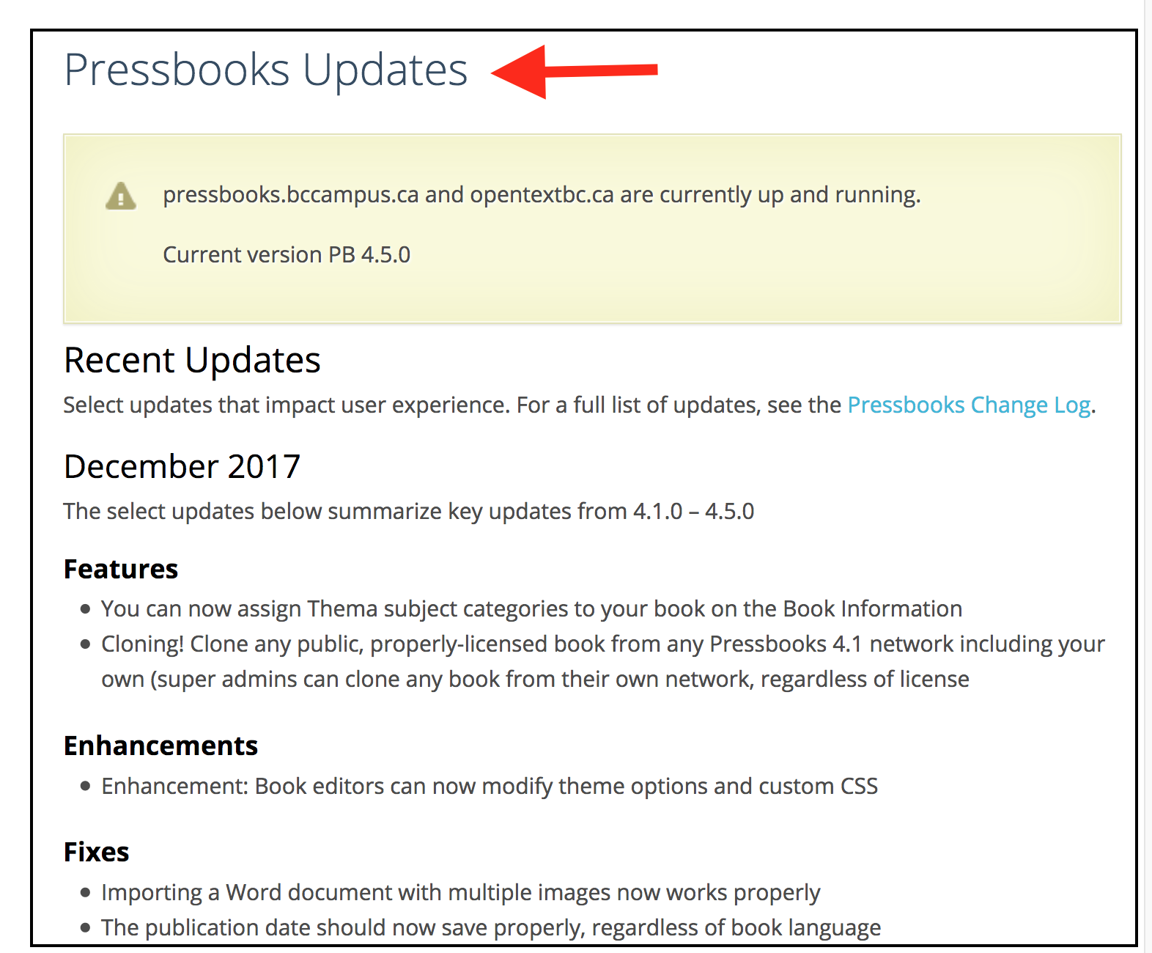
Pressbooks Updates
Notes:
For Pressbooks updates about recent upgrades, new features, enhancements, and fixes, go to the BCcampus Open Education site at open.bcampus.ca, select ”Pressbooks Support,” and then “Pressbooks Updates” at the top of the drop-down list.

Slide 48
Questions?
open.bccampus.ca

